Slide 1
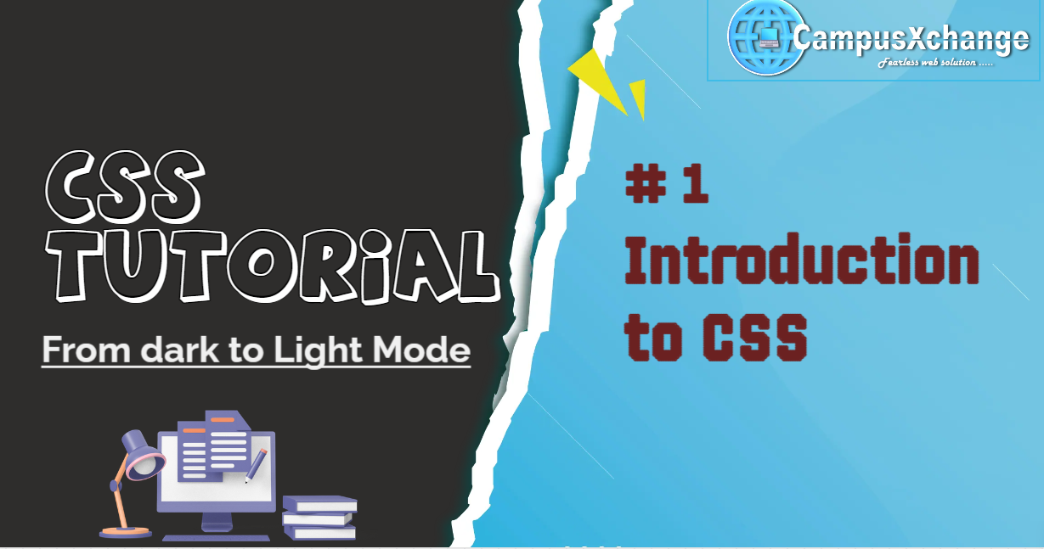

Slide 2



What is CSS ?
CSS stands for Cascading Style Sheets.
CSS was conceptualized and proposed by Hakon Wium Lie in 1994.
The first official version “CSS1” was released in December 1996.
CSS is the language we use to style an HTML document.
It is used to design the layout of webpage and used to give styles to the page .
Before CSS
After CSS

Slide 3
CSS Versions
CSS1
The first official version of CSS, it was published in December 1996. It introduced basic features for text styling, font properties, margins, padding, color and background styling, and the box model.
2. CSS2
It was released in May 1998, CSS2 expanded upon CSS1 by adding more styling selectors, positioning capabilities, media types, and additional properties to enhance styling options.
3. CSS 2.1
An important revision known as CSS 2.1 addressed inconsistencies and errors found in CSS2. It became a W3C Recommendation in June 2011 and is widely supported across all major browsers.
4. CSS3
CSS3 is an upgraded version of CSS that adds modern styling capabilities like animations, transitions, gradients, flexbox, grid, and more.
It allows developers to create interactive, responsive, and visually rich web pages without using much JavaScript or images.

Slide 4
CSS Syntax
Selector_name{
declaration;
}
Example -
p { color: red; }
p is a selector in CSS (which select all <p> elements).
color: red ; is declaration of the CSS selector.
color is a property, and red is the property value

Slide 5
Types of Selectors
Universal Selector: Applies styles to all elements.
* {
margin: 0;
}
2. Name Selector: it select all elements with specific name.
h1 {
color: white;
}
3. Class Selector: Styles elements with a specific class attribute.
box
{
border: 1px solid black;
}
4. ID Selector: Targets a single element with a specific ID.
#home_box
{
background-color: skyblue;
}

